Slide 1

Exploratory data Analysis
Bharti Jagyasi

Slide 2
Introduction of EDA
Exploratory Data Analysis, or EDA, is a powerful technique used to cleanse, analyze, and visualize data. It allows us to uncover hidden patterns, understand data distributions, and identify potential relationships between variables. This initial exploration serves as the bedrock for building effective models, including those used for real estate price prediction. This exploration lays the groundwork for building robust models for tasks like price prediction.

Slide 3
Data Acquisition and Cleaning
We'll use the Pandas library, a workhorse for data manipulation in Python, to load our dataset from its CSV or Excel format. This involves addressing missing values, eliminating duplicate entries, and identifying and correcting any inconsistencies. A clean and reliable dataset is paramount for drawing accurate conclusions from our analysis. This cleaning process ensures a reliable foundation for our analysis.

Slide 4
Understanding the data and variables
We'll focus on key features that influence house prices, such as the property's size (square footage) and the number of bedrooms. To understand the distribution of these variables. Histograms, kernel density plots, and other visualizations will be used to explore their distributions. Analyzing individual variables provides insights into their central tendencies and spread.

Slide 5
Univariate Analysis and Multivariate Analysis
Univariate analysis involves examining the distribution of a single variable. It helps in understanding the central tendency, dispersion, and shape of the variable's distribution.
Multivariate analysis explores the relationships between multiple variables. It uncovers patterns, correlations, and interactions among various factors affecting house pricing.
Feature Engineering :
It involves creating new features from existing ones to improve model performance.
Size Impact :
The size of a house significantly affects its market value and pricing.

Slide 6
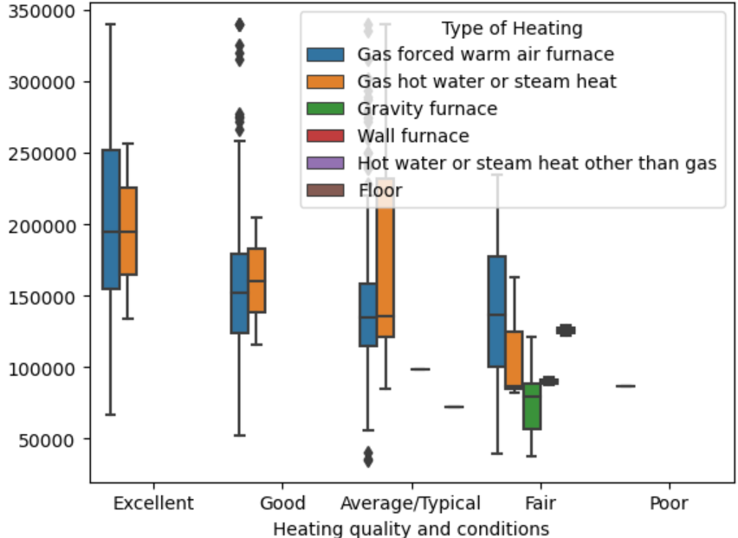
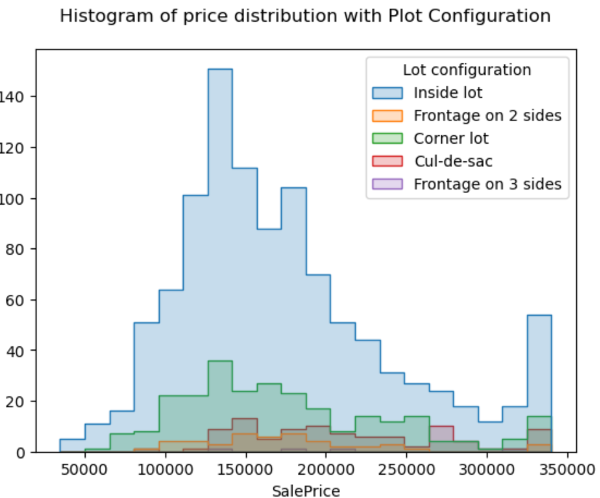
Univariate Analysis and Multivariate Analysis

Slide 7
Analysis about DATA
*Kitchen Quality and House Price
Houses with Excellent Quality Kitchen are the ones with highest price
Good Quality Kitchens are the ones with 2nd highest price.
*Heating Quality and Condition VS House Price
Excellent Heating Quality and conditions have got the highest price
Fair condition Heating condition and Poor conditions are the 2nd least and least Sale Price house holds
PavedDrive way is the choice that customers are looing for , it should be incorporated on the design and implementation part
.

